Slide 1
DID YOU KNOW?
Over 600,000 HIV patients die each year [1]
Over 40% of HIV patients are lost to follow-up [2]

Slide 2
LIFE PROGNOSIS MANAGEMENT TOOL
A Lifespan Prediction System
Calvin Prince
Amanuel Kebede
El Yadah Kalisimbi

Slide 3
b
AGENDA
Introduction
Background
Impact
Key Features
Design
Project Demo
01
02
03
04
05
06

Slide 4

INTRODUCTION
This is a command-line system designed to estimate the remaining lifespan of individuals living with HIV based on specific health and demographic data such as age, country, diagnosis date, and whether the patient is on antiretroviral therapy (ART).

Slide 5


IMPACT ON SUB-SAHARAN AFRICA (SSA)
01
02
03
04
Prioritize patients with higher risks for immediate intervention.
Design targeted public health campaigns, and allocate resources more effectively.
Track the effectiveness of HIV programs.
Patients can make informed decisions about their health and treatment options.

Slide 6

Mathematical Model
Calculates predicted remaining lifespan
KEY FEATURES
Data Analysis
Generates reports and statistics

Slide 7
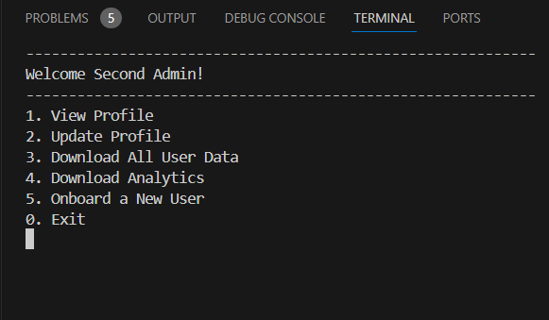
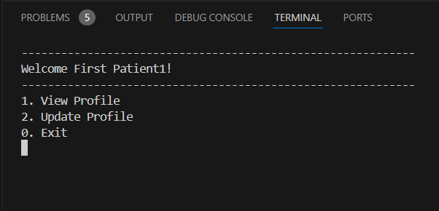
KEY FEATURES (Cont’d)
Only admins can access, compile all user data into a file, and download them.

Slide 8
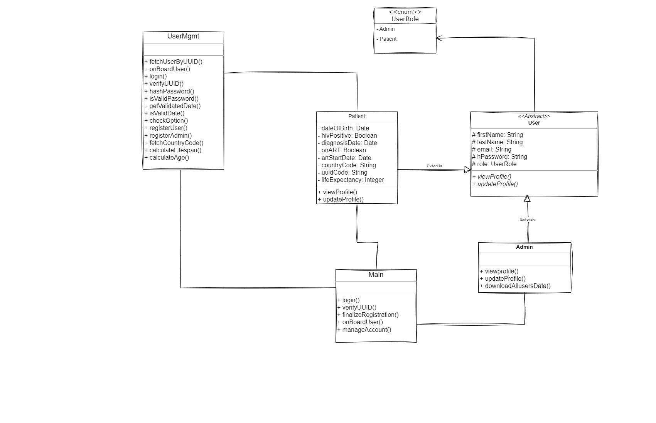
DESIGN
(Class Diagram)

Slide 9



PROJECT DEMO

Slide 10
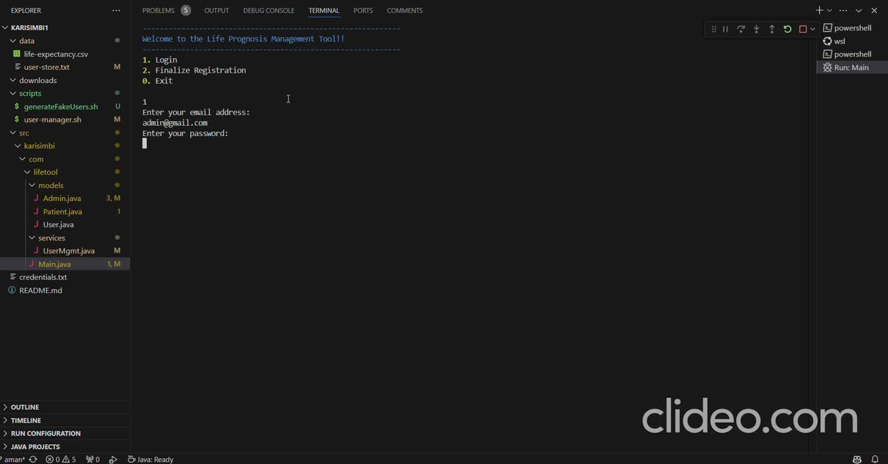

Slide 11

REFERENCES
[1] “Life expectancy for people living with HIV,” aidsmap.com. Accessed: Aug. 14, 2024. [Online]. Available: https://www.aidsmap.com/about-hiv/life-expectancy-people-living-hiv
[2] “Predictors of mortality rate among adult HIV-positive patients on antiretroviral therapy in Metema Hospital, Northwest Ethiopia: a retrospective follow-up study | AIDS Research and Therapy | Full Text.” Accessed: Aug. 14, 2024. [Online]. Available: https://aidsrestherapy.biomedcentral.com/articles/10.1186/s12981-021-00353-z
[3] Akgun K. M., Tate J. P., Crothers K., Crystal S., Leaf D. A., Womack J., . . . Oursler K. K. (2014). An adapted frailty-related phenotype and the VACS index as predictors of hospitalization and mortality in HIV-infected and uninfected individuals. Journal of Acquired Immune Deficiency Syndromes, 67, 397-404
[4] “Person centered HIV patient monitoring.” Accessed: Aug. 08, 2024. [Online]. Available: https://www.who.int/teams/global-hiv-hepatitis-and-stis-programmes/hiv/strategic-information/person-centered-hiv-patient-monitoring

Slide 12


THANK YOU!!!
Any questions?

